Slide 1
Unit-2

Slide 2
Network Protocol
Protocols are set of rules that help in governing the way a particular technology will function for communication.
While surfing user use different networks and network protocols.
There are various types of protocols that support a major and compassionate role in communicating with different devices across the network.

Slide 3
Network Protocol
These are:
Transmission Control Protocol (TCP)
Internet Protocol (IP)
User Datagram Protocol (UDP)
Post office Protocol (POP)
Simple mail transport Protocol (SMTP)
File Transfer Protocol (FTP)
Hyper Text Transfer Protocol (HTTP)
Hyper Text Transfer Protocol Secure (HTTPS)
Telnet
Gopher

Slide 4
Layered Network Architecture
The main aim of the layered architecture is to divide the design into small pieces.
Each lower layer adds its services to the higher layer to provide a full set of services to manage communications and run the applications.
It provides modularity and clear interfaces, i.e., provides interaction between subsystems.
The number of layers, functions, contents of each layer will vary from network to network.

Slide 5
Layered Network Architecture
The basic elements of layered architecture are services, protocols, and interfaces.
Service: It is a set of actions that a layer provides to the higher layer.
Protocol: It defines a set of rules that a layer uses to exchange the information with peer entity. These rules mainly concern about both the contents and order of the messages used.
Interface: It is a way through which the message is transferred from one layer to another layer.

Slide 6
Layered Network Architecture
Why do we require Layered architecture?
Divide-and-conquer approach: Divide-and-conquer approach makes a design process in such a way that the unmanageable tasks are divided into small and manageable tasks. In short, we can say that this approach reduces the complexity of the design.
Modularity: Layered architecture is more modular. Modularity provides the independence of layers, which is easier to understand and implement.
Easy to modify: It ensures the independence of layers so that implementation in one layer can be changed without affecting other layers.
Easy to test: Each layer of the layered architecture can be analysed and tested individually.

Slide 7
OSI Reference Model
To deal with connecting systems that are open for communication with other systems.
OSI Layer Model (Open Systems Interconnection)
Developed by the International Standards Organization (ISO) with seven different layers.
Physical Layer
Data Link Layer
Network Layer
Transport Layer
Session Layer
Presentation Layer
Application Layer

Slide 8
Example – Air Plane Travel
Departure
Arrival
ticket (purchase)
baggage (check)
gates (load)
runway takeoff
airplane routing
ticket (complain)
baggage (claim)
gates (unload)
runway landing
airplane routing

Slide 9
How OSI Layer Works?

Slide 10
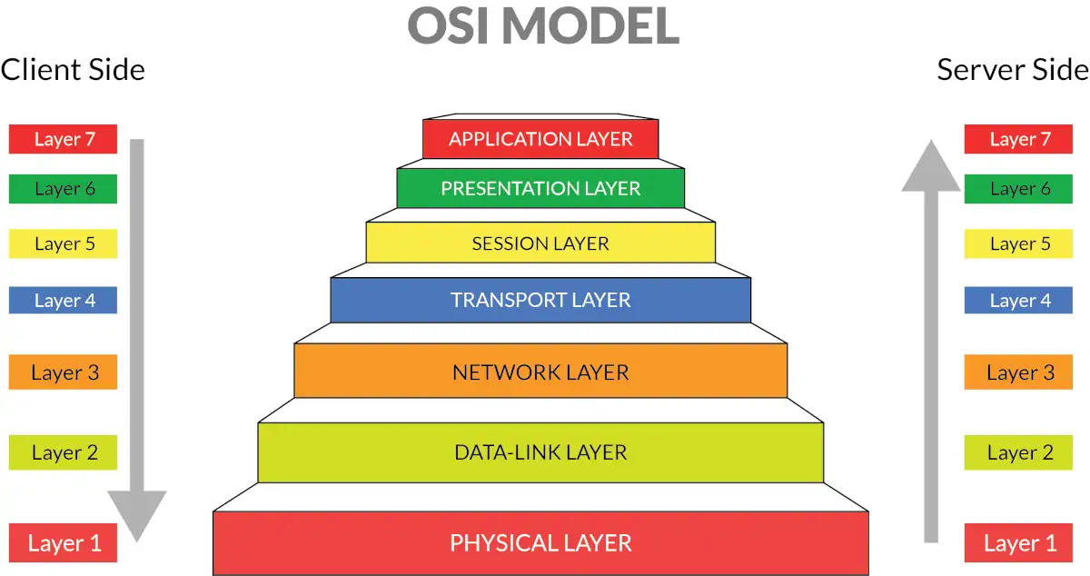
Open Systems Interconnect (OSI) OSI Reference Model

Slide 11
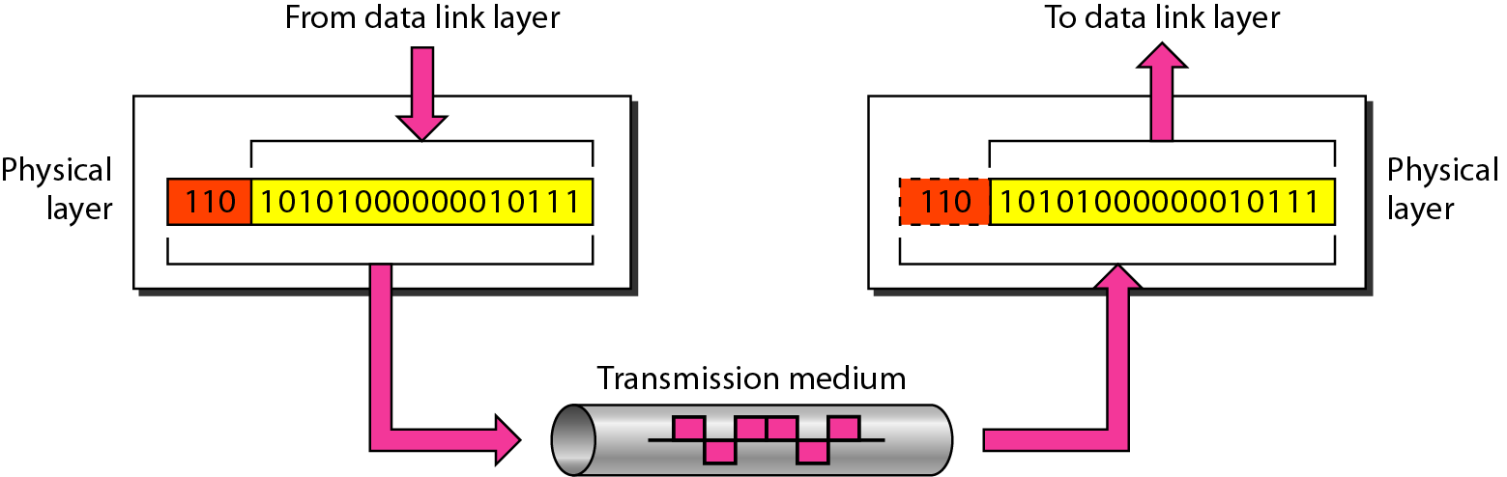
Physical Layer
The physical layer is responsible for movements of individual bits from one hop (node) to the next.

Slide 12
Physical Layer
It is the lowest layer of the OSI model.
It is responsible for the actual physical connection between the devices.
It establishes, maintains and deactivates the physical connection.
The physical layer contains information in the form of bits.
The main functionality of the physical layer is to transmit the individual bits from one node to another node.
This layer will get the signal and send it to the Data Link layer.
Hub, Repeater, Modem, Cables are Physical Layer devices

Slide 13
Functions of a Physical layer
Line Configuration:
It defines the way how two or more devices can be connected physically.
Signals:
It determines the type of the signal used for transmitting the information.
Bit synchronization:
It provides the synchronization of the bits by providing a clock. This clock controls both sender and receiver thus providing synchronization at bit level.
Bit rate control:
It also defines the transmission rate i.e. the number of bits sent per second.
Physical topologies:
It specifies the way in which the different, devices/nodes are arranged in a network i.e. bus, star, or mesh topology.
Transmission mode:
It also defines the way in which the data flows between the two connected devices.
The various transmission modes possible are Simplex, half-duplex and full-duplex.

Slide 14
Physical Layer – Cont…
Carries the bit stream over a physical media.
Physical Layer is concerned with:
Interface and Medium like guided cables
Representation of bits
Data rate
Synchronization of bits
Line configuration
Physical topology
Transmission mode

Slide 15
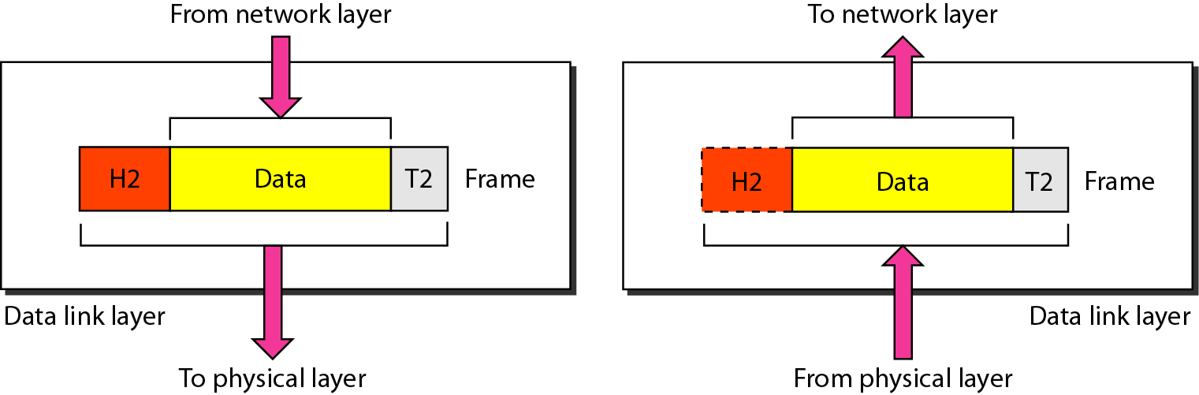
Data Link Layer
The data link layer is responsible for moving frames from one hop (node) to the next.

Slide 16
Data-Link Layer
This layer is responsible for the error-free transfer of data frames.
It provides hop-to-hop delivery.
It defines the format of the data on the network.
It provides a reliable and efficient communication.
It is mainly responsible for the unique identification of each device that resides on a local network.
When a packet arrives in a network, it is the responsibility of DLL to transmit it to the Host using its MAC address
Packet in Data Link layer is referred to as Frame
Data Link layer is handled by the NIC (Network Interface Card) and device drivers of host machines
Switch & Bridge are Data Link Layer devices.

Slide 17
Data-Link Layer
Data Link Layer is divided into two sublayers:
Logical Link Control Layer
It is responsible for transferring the packets to the Network layer.
It identifies the address of the network layer protocol from the header.
It also provides flow control.
Error detection, using Ethernet trailer field frame check sequence (FCS).
Media Access Control Layer
Provides physical addressing
A Media access control layer is a link between the Logical Link Control layer and the network's physical layer.
It is used for transferring the packets over the network.
The packet received from the Network layer is further divided into frames depending on the frame size of NIC (Network Interface Card).
DLL also encapsulates Sender and Receiver’s MAC address in the header.

Slide 18
Functions of the Data-link layer
Framing:
Framing is a function of the data link layer.
The data link layer translates the physical's raw bit stream into packets known as Frames.
Breaks messages into frames and reassembles frames into messages
Attaching special bit patterns to the beginning and end of the frame.
The Data link layer adds the header and trailer to the frame.
Physical Addressing:
The Data link layer adds a header to the frame that contains destination and source addresses.
The frame is transmitted to the destination address mentioned in the header.

Slide 19
Functions of the Data-link layer
Flow Control:
It is the main functionality of the Data-link layer.
It is the technique through which the constant data rate is maintained on both the sides so that no data get corrupted.
It keeps a fast transmitter from flooding a slow receiver.
Error Control:
Adding a calculated value CRC (Cyclic Redundancy Check) that is placed to the Data link layer's trailer.
The CRC is added to the message frame before it is sent to the physical layer.
If any error seems to occur, then the receiver sends the acknowledgment for the retransmission of the corrupted frames.
Data link layer provides the mechanism of error control in which it detects and retransmits damaged or lost frames.
Access Control:
When two or more devices are connected to the same communication channel, then
The data link layer protocols are used to define which device has control over the communication link at a given time.

Slide 20
Data Link Layer – Cont…
Data link layer is concerned with:
Framing – divide bits stream into data unit (frame)
Physical addressing
Flow control – avoid over overwhelming
Error control – bit loses, retransmission
Access control

Slide 21
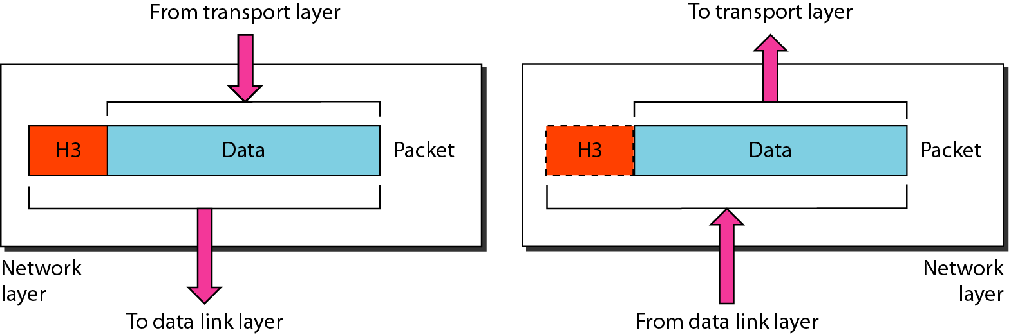
Network Layer
The network layer is responsible for the delivery of individual packets from the source host to the destination host.

Slide 22
Functions of Network Layer
Internetworking:
An internetworking is the main responsibility of the network layer.
It provides a logical connection between different devices.
Addressing:
In order to identify each device on internetwork uniquely, the network layer defines an addressing scheme.
A Network layer adds the source and destination IP addresses to the header of the frame.
Addressing is used to identify the device uniquely and universally on the internet.
Routing:
Routing is the major component of the network layer, and it determines the best optimal path out of the multiple paths from source to the destination.
Packetizing:
A Network Layer receives the packets from the upper layer and converts them into packets.
This process is known as Packetizing.
It is achieved by internet protocol (IP).

Slide 23
Network Layer – Cont…
In this layer, packet is combined with header and data.
In case of data link layer, packet delivers on the same network.
If two different networks are connected then packet is concern with network layer.
Network layer is concerned with:
Logical addressing e.g. 192.168.1.1 (IP Address)
Routing

Slide 24
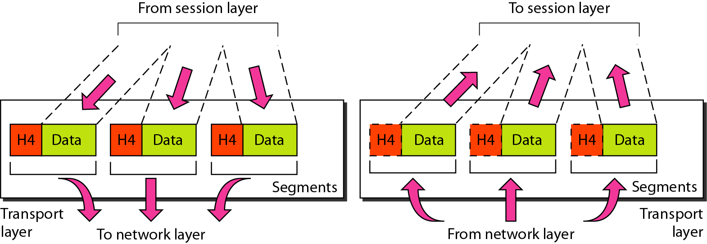
Transport Layer
The transport layer is responsible for the delivery of a message from one process to another.

Slide 25
Functions of Transport Layer
At sender’s side:
Transport layer receives the formatted data from the upper layers, performs Segmentation,
Implements Flow & Error control to ensure proper data transmission.
It also adds Source and Destination port numbers (which is associated with the receiver’s application) in its header and forwards the segmented data to the Network Layer.
Generally, this destination port number is configured, either by default or manually.
For example, a web server typically uses port number 80 by default.
At receiver’s side:
Transport Layer reads the port number from its header and forwards the Data that it has received to the respective application.
It also performs sequencing and reassembling of the segmented data.

Slide 26
Transport Layer – Cont…
This layer ensures that the whole message arrives intact and in order.
Transport layer is concerned with:
Service-point addressing (port address)
Segmentation and Reassembly
Connection Control
Flow and Error Control

Slide 27
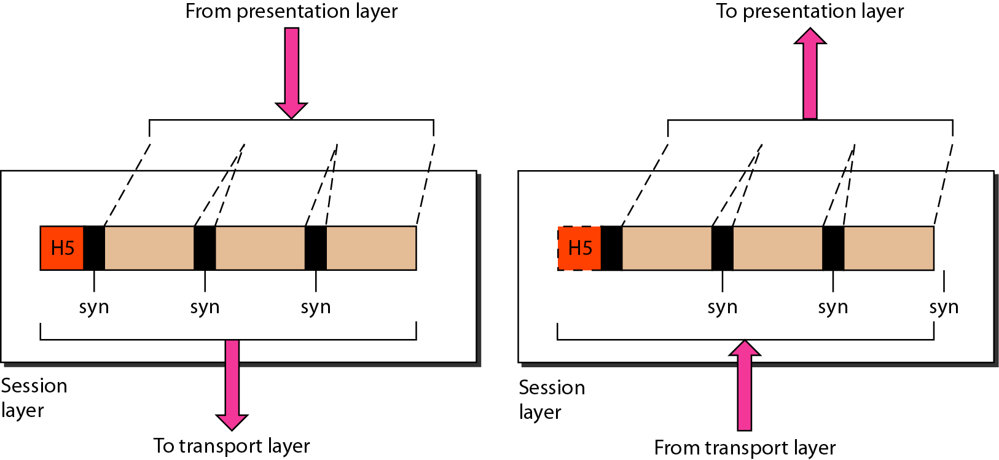
Session Layer
The session layer is responsible for dialog control and synchronization.

Slide 28
Functions of Session layer
Session establishment, maintenance, and termination:
The layer allows the processes to establish, use and terminate a connection.
Dialog control:
Session layer acts as a dialog controller that creates a dialog between two processes.
In simple words, it allows the communication between two processes which can be either half-duplex or full-duplex.
Synchronization:
Session layer adds some checkpoints when transmitting the data in a sequence.
If some error occurs in the middle of the transmission of data, then the transmission will take place again from the checkpoint.
This process is known as synchronization and recovery.
Data loss is avoided by it.

Slide 29
Session Layer – Cont…
This layer is network dialog controller – establishes, maintains, synchronizes the interaction among computers.
Session layer is concerned with:
Dialog control
Synchronization

Slide 30
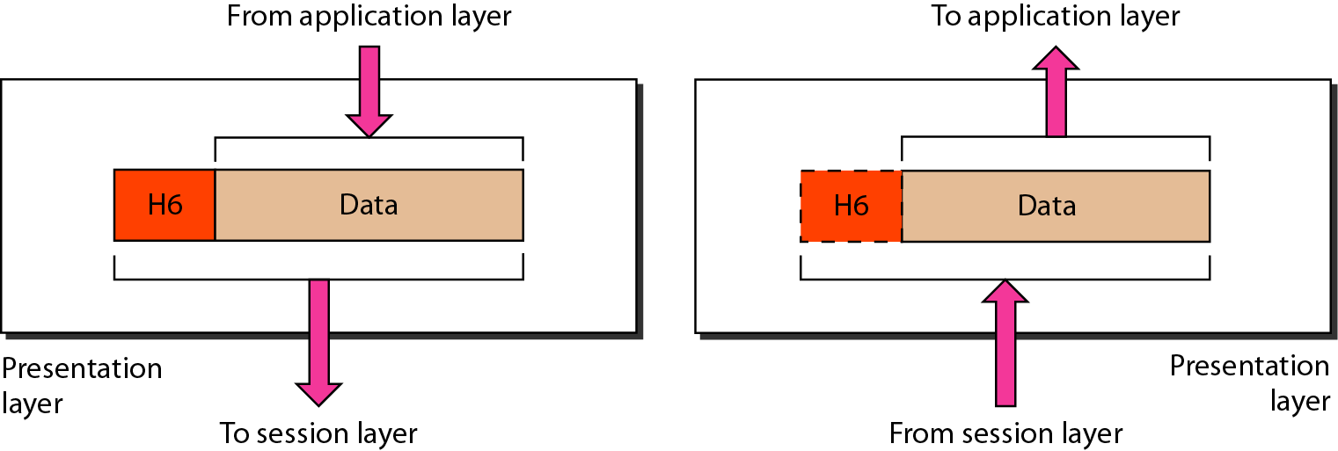
Presentation Layer
The presentation layer is responsible for translation, compression, and encryption.

Slide 31
Presentation Layer
The presentation layer is also called the Translation layer.
The data from the application layer is extracted here and manipulated as per the required format to transmit over the network.
This layer is a part of the operating system that converts the data from one presentation format to another format.
The Presentation layer is also known as the syntax layer.

Slide 32
Functions of Presentation layer
Translation:
It acts as a data translator for a network, for example, ASCII to EBCDIC
The processes in two systems exchange the information in the form of character strings, numbers and so on.
Different computers use different encoding methods, the presentation layer handles the interoperability between the different encoding methods.
It converts the data from sender-dependent format into a common format and changes the common format into receiver-dependent format at the receiving end.
Encryption:
Encryption is needed to maintain privacy.
Data encryption translates the data into another form or code.
The encrypted data is known as the ciphertext and the decrypted data is known as plain text.
A key value is used for encrypting as well as decrypting data
Compression:
Data compression reduces the number of bits that need to be transmitted on the network
Data compression is very important in multimedia such as text, audio, video.

Slide 33
Presentation Layer – Cont…
This layer is concerned with the syntax which refers to order in which data is presented and semantics helps in interpreting a particular pattern.
Presentation layer is responsible for:
Translation
Encryption
Compression

Slide 34
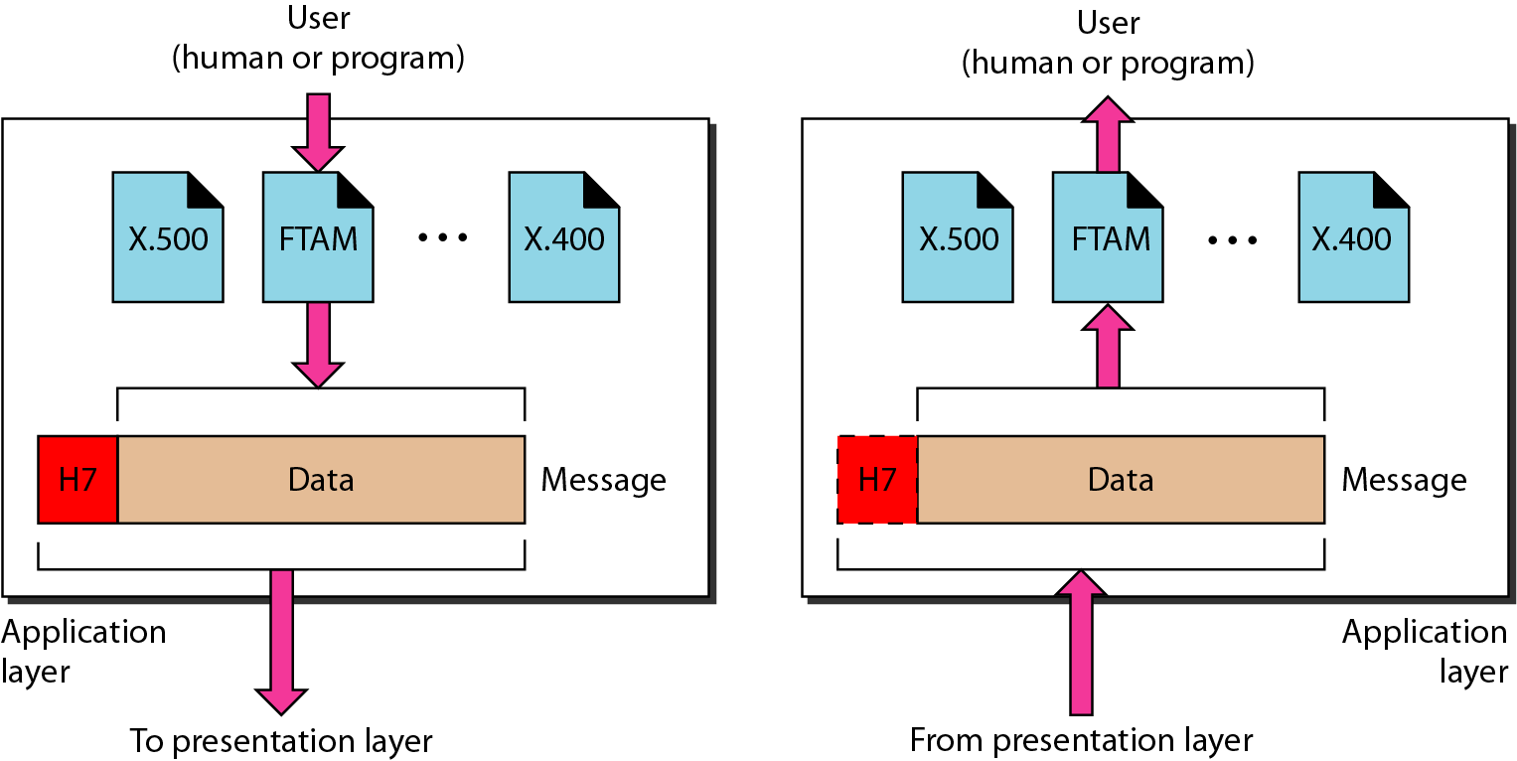
Application Layer
The application layer is responsible for providing services to the user.

Slide 35
Application Layer
Application layer, which is implemented by the network applications is the top most layer of the OSI OSI Reference Model.
These applications produce the data, which has to be transferred over the network.
This layer also serves as a window for users and the application services to access the network and for displaying the received information to the user.
It handles issues such as network transparency, resource allocation, etc.
This layer provides the network services to the end-users.
Example: Application – Browsers, Skype Messenger, etc.
Application Layer is also called Desktop Layer.

Slide 36
Functions of Application layer
File transfer, access, and management (FTAM):
An application layer allows a user to access the files in a remote computer, to retrieve the files from a computer and to manage the files in a remote computer.
Mail services:
An application layer provides the facility for email forwarding and storage.
Directory services:
An application provides the distributed database sources and is used to provide that global information about various objects.

Slide 37
Application Layer – Cont…
This layer provides various services like:
Network virtual terminal
File transfer, access and management
Mail services
Directory services

Slide 38
Summary – OSI Layer
To allow access to network resource
Application
To translate, encrypt and compress data
Presentation
To establish, manage and terminate sessions
To provide reliable process-to-process message delivery and error recovery
Session
Transport
To move packets from source to destination; To provide internetworking
Network
To organize bits into frames; To provide hop-to-hop delivery
Data link
To transmit bits over a medium; To provide mechanical & electrical specification
Physical

Slide 39
TCP/IP Reference Model (Transmission Control Protocol/Internet Protocol)
It was originally defined as having four layers:
TCP/IP is a set of protocols developed to allow cooperating computers to share resources across the network.
Application Layer
Transport Layer
Internet Layer
Network Interface Layer

Slide 40
TCP/IP Model Architecture

Slide 41
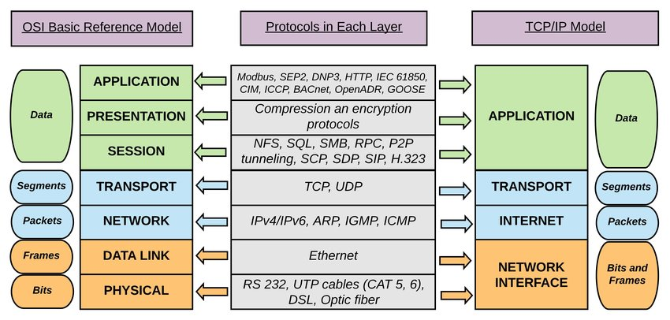
Comparison

Slide 42
Differences between OSI Model and TCP/IP Protocol Layers
OSI (Open System Interconnection) | TCP/IP (Transmission Control Protocol/ Internet Protocol)
It has 7 layers | It has 5 layers
Protocols are hidden in OSI model and are easily replaced as the technology changes | In TCP/IP, replacing protocol is not easy
Follows horizontal approach | Follows vertical approach
OSI model has a separate presentation layer | TCP/IP doesn’t have a separate presentation layer
OSI model defines services, interfaces and protocols very clearly and makes clear distinction between them | In TCP/IP, it is not clearly separated its services, interfaces and protocols
In OSI model the transport layer guarantees the delivery of packets | In TCP/IP model the transport layer does not guarantees delivery of packets

Slide 43
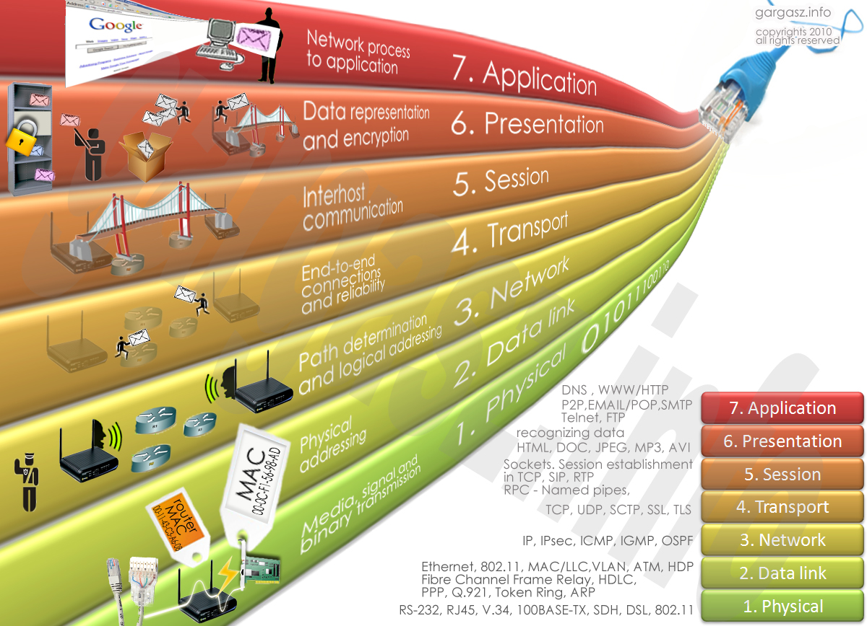
Protocol Layers: Summary

Slide 44
Delay, Loss & Throughput
Delay
As a packet travels from one node (host or router) to the subsequent node (host or router) along this path, the packet suffers from several types of delays at each node along the path.
Where
d_{nodal} = d_{proc} + d_{queue} + d_{tran} + d_{prop}
d_{nodal} | = | Total Delay
d_{proc} | = | Processing Delay
d_{queue} | = | Queuing Delay
d_{tran} | = | Transmission Delay
d_{prop} | = | Propagation Delay

Slide 45
Delay – Cont…
Processing Delay (d_{proc})
The time required to examine the packets header and determine where to direct the packet.
To check bit level error
Determine output link
Delay in terms of microseconds

Slide 46
Delay – Cont…
Queuing Delay (d_{queue})
A time to wait at output link for transmission.
Depends on congestion level of router.
If queue is empty, then delay will be zero.
If queue is full (heavy traffic) then delay will be long.
Delay in terms of microsecond to millisecond.

Slide 47
Delay – Cont…
Transmission Delay (d_{tran} = L/R)
An amount of time required for the router to transmit the packet.
It is depending on packet length(L) and transmission rate(R) of link.

Slide 48
Delay – Cont…
Propagation Delay (d_{prop}= d/s)
A time required to propagate from the beginning of the link to router B.
Depends on the length of physical medium(d) link and propagation speed(s) of link
Delay in terms of millisecond.

Slide 49
Packet Loss
Packet loss is the failure of one or more transmitted packets to arrive at their destination.
The loss of data packets depends on the switch queue/buffer. The loss of data packets increases with the increases in the traffic intensity.
It affects the performance
of the network.

Slide 50

Throughput
Throughput or Network Throughput is the rate of successful message delivery over a communication channel.
Throughput is measured in bits(data) per second (bit/s or bps)
server, with
file of F bits
send to client
link capacity
R_{s} bits/sec
link capacity
R_{c} bits/sec

